Slide 1



Connecting The Dots Showing Relationships in Data and Beyond
Marc Streit¹, Hans-Jörg Schulz², Alexander Lex³
VisWeek Tutorial 2012
Johannes Kepler University Linz, Austria
University of Rostock, Germany
Harvard School of Engineering and Applied Sciences, Cambridge, MA, USA

Slide 2
Part III: WHEN to LINK?
Speaker: Marc Streit
Notes:
Scenarios when linking can be applied

Slide 3


Heterogeneity of Linking
Display 1
Display 2
Application 1
Application 2
Application 3
View 1
View 2
View 3
View 4
User 1
User 2
User 3

Slide 4
Clarification
Part III orthogonal to Part I and II
Could be linking on data/view/interaction level
Could be any linking technique

Slide 5
View vs. Visualization
Visualization
Visual representation that
is based on (non-visual) data
produces an image
is readable and recognizable
View
Physical display space (most often 2D) where a visual structure is rendered
[Kosara 2008]
[Card, Mackinlay and Shneiderman 1999]

Slide 6
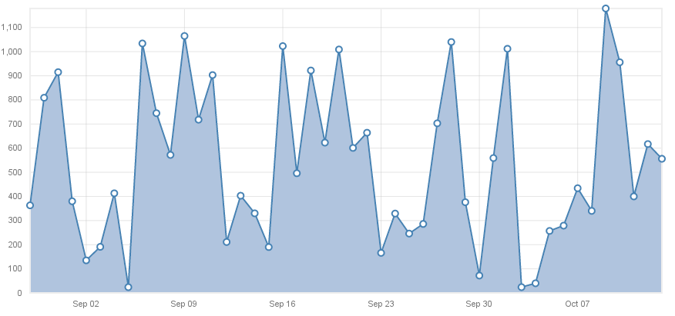
Single Visualization
Showing a single relationship in the data
D3.js Line Chart Example
Notes:
D3 = Data Driven Documents
D3.js is a JavaScript library for manipulating documents based on data. D3 helps you bring data to life using HTML, SVG and CSS. D3’s emphasis on web standards gives you the full capabilities of modern browsers without tying yourself to a proprietary framework, combining powerful visualization components and a data-driven approach to DOM manipulation.
Tutorial today in the morning sessions

Slide 7

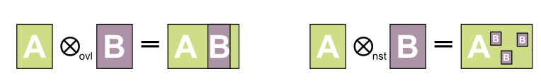
Composite Visualization Views (CVV)
[Javed and Elmqvist 2012]
Create new visualizations by combining different visualizations
Juxtaposition (Integrated Views)
Superimposition
Overloading
Nesting
Notes:
Design patterns

Slide 8
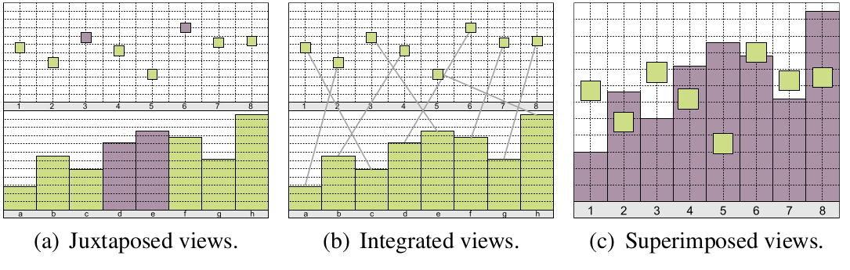
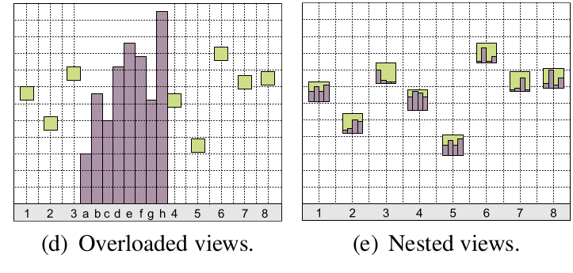
Composite Visualization Views (CVV)
[Javed and Elmqvist 2012]
Notes:
Bar chart + scatterplot

Slide 9
Linking WITHIN a Single View
Display 1
Display 2
Application 1
Application 2
Application 3
View 1
View 2
View 3
View 4
User 1
User 2
User 3

Slide 10
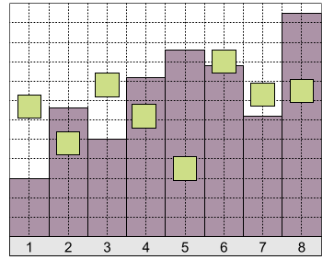

Composite Vis: Superimposition
Overlay of two or more visual spaces on top of each other
1:1 spatial linking

Slide 11

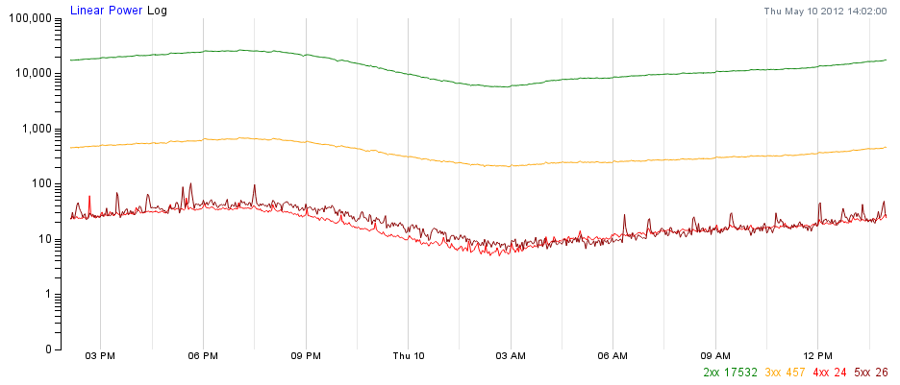
Superimposition Example
Superimposition
With several data series
D3.js Interactive Line Graph Example

Slide 12
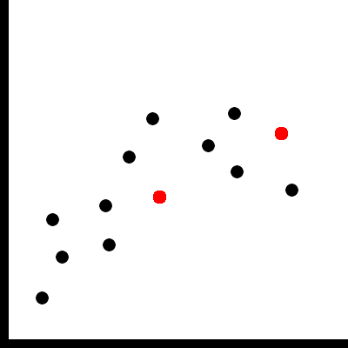
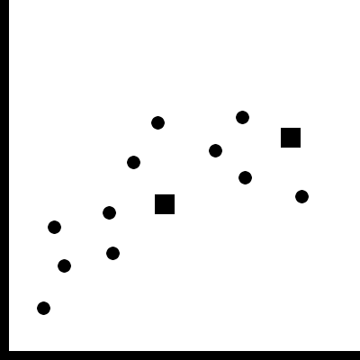
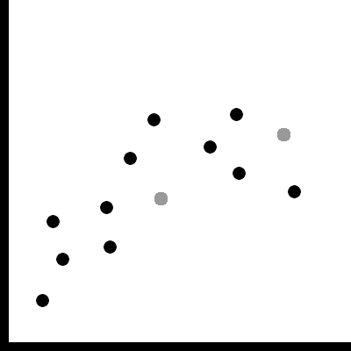
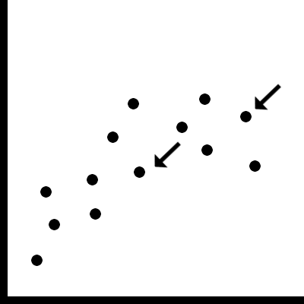
Base Representation with Supplemented Links
Superimposition
Color
Shape
Value
Glyph

Slide 13
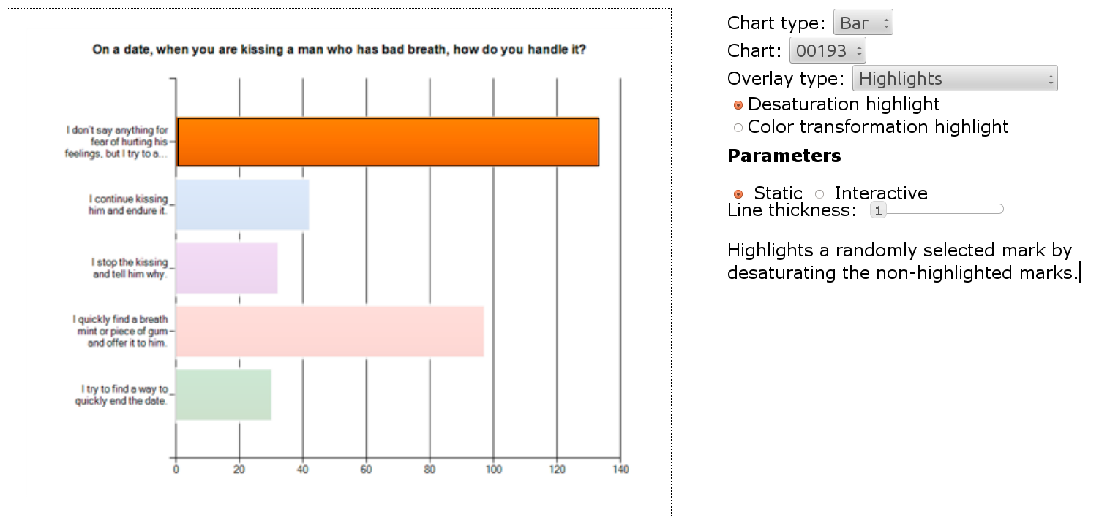
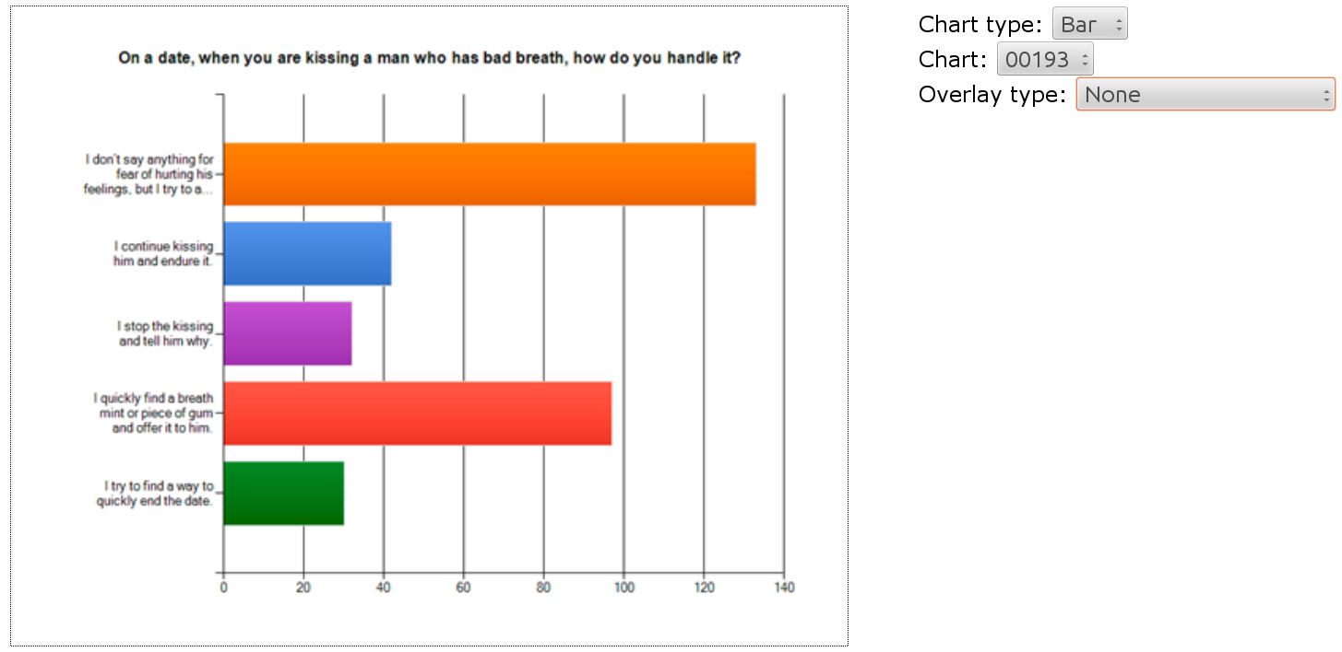
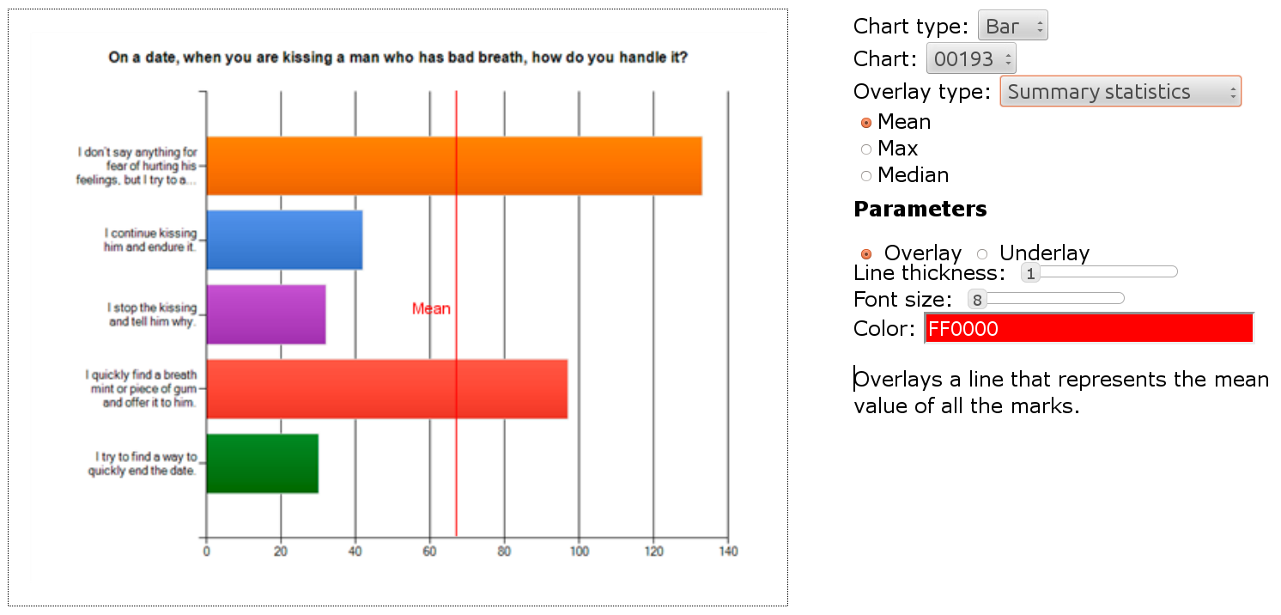
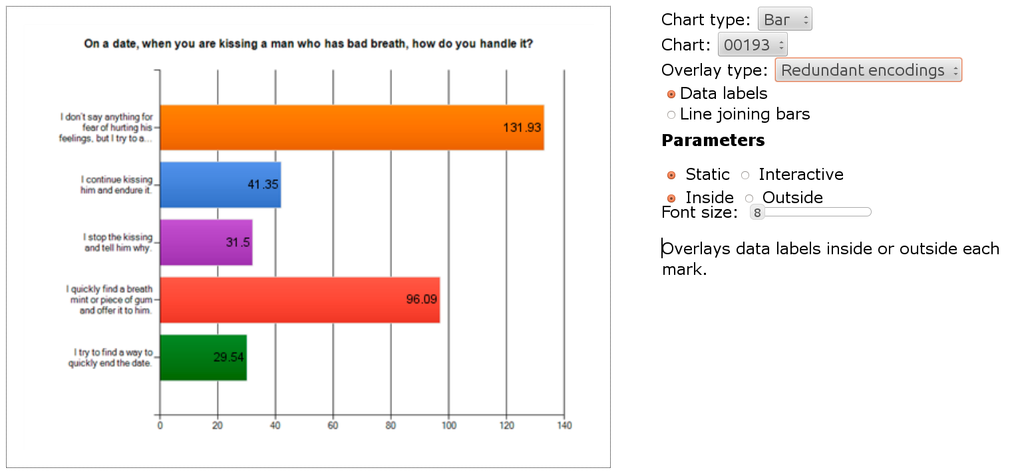
Example: Graphical Overlays
Superimposition
[Kong and Agrawala 2012]
2nd InfoVis Session on Wednesday
More examples: http://vis.berkeley.edu/papers/grover

Slide 14
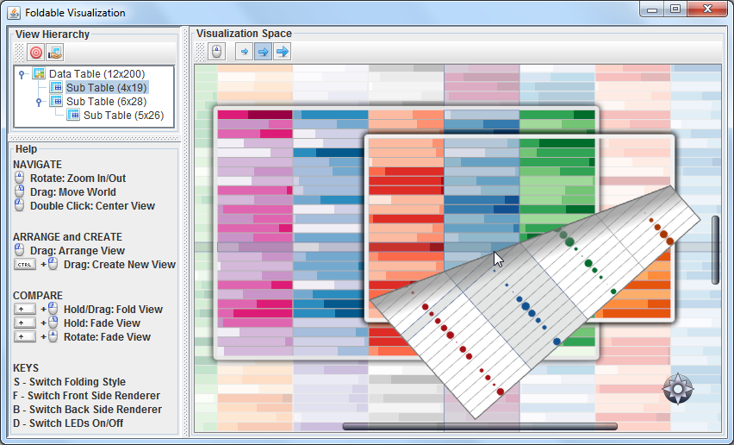
Visual Comparison Inspired by Natural Behavior
Superimposition
1st InfoVis session on Thursday
FoldableVis [Tominski et al. 2012]
Notes:
interaction techniques that assist in con-
ducting comparison tasks for table-based and matrix-based visual
representations.
Temporarily fold layers away

Slide 15
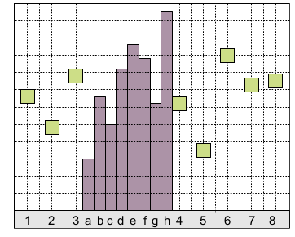

Composite Vis: Overloading
One visualization rendered inside another visualization
Host / client visualization
Same spatial mapping
No 1:1 spatial linkling
Notes:
While previous design patterns have all operated on speciﬁc
views of component visualizations, overloaded views (and also the
next pattern, Nested Views) operate on the visual structure themselves. In other words, it is no longer possible to merely use visual layout operations to organize the views together, but the visual structures themselves must be modiﬁed to combine the components. We will see examples of this below

Slide 16

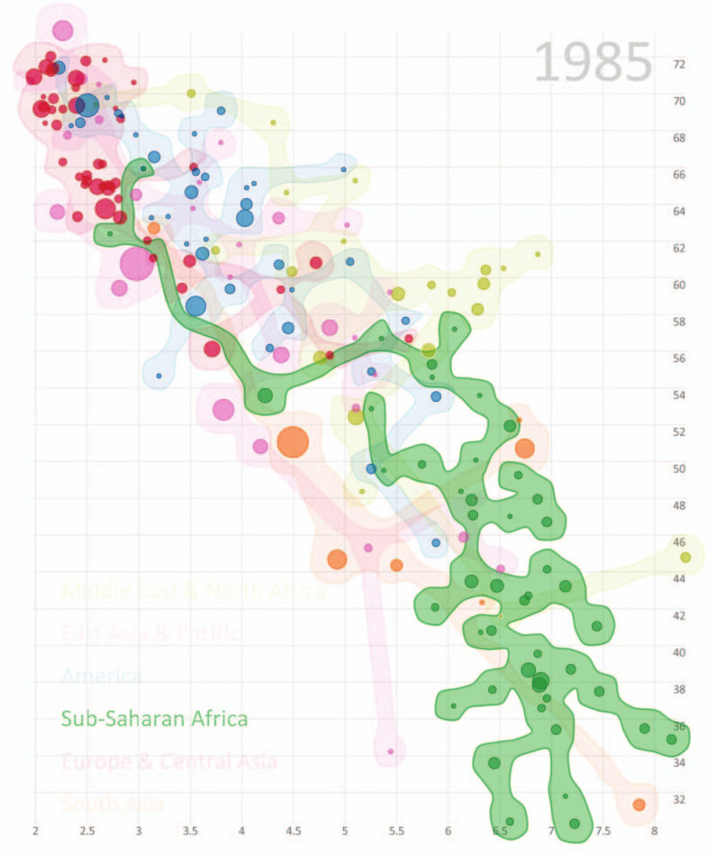
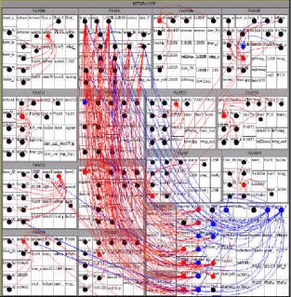
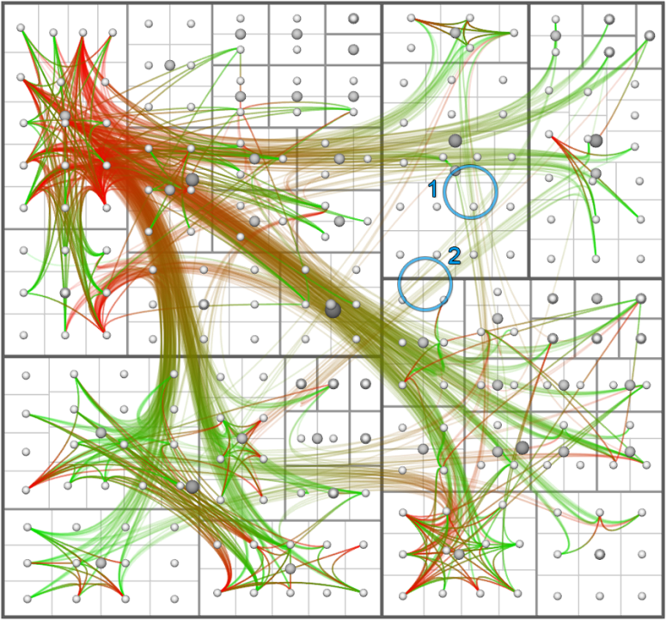
Overloading Examples
Overloading
Treemap Overlay [Fekete et al. 2003]
HEB [Holten et al. 2006]
[Collins et al. 2009]
Notes:
graph links are not just a separate
layer on top of the treemap, but they are embedded into the visual
structure of the treemap and use the node positions as anchors.

Slide 17
Linking Across Multiple Views
Display 1
Display 2
Application 1
Application 2
Application 3
View 1
View 2
View 3
View 4
User 1
User 2
User 3

Slide 18

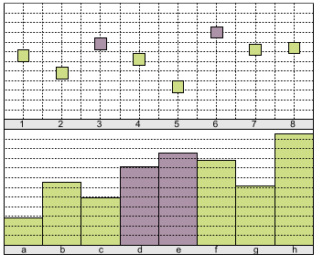
Composite Vis: Juxtaposition
Show visualizations in a side-by-side fashion
Very prominent paradigm

Slide 19

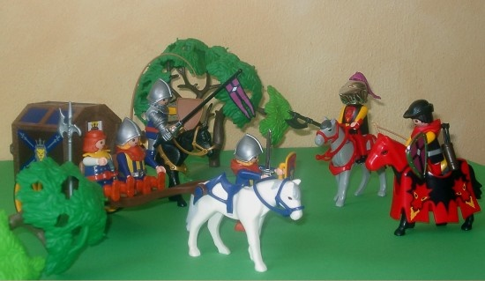
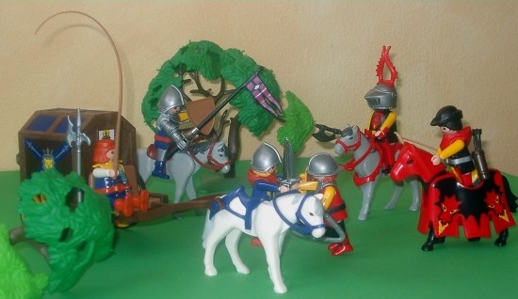
Manual Comparison
Juxtaposition
Cognitive work

Slide 20
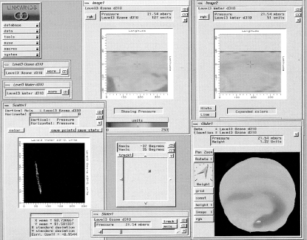
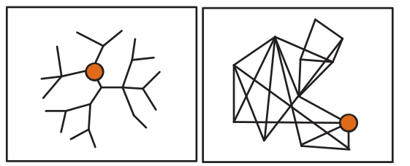
Multiple Coordinated Views
Juxtaposition
Actions in one view can be related to other view
Premise: View and interact with data through different representations
Coordination on diff. levels
[Colins and Carpendale 2007]
LinkWinds [Jacobson et al. 1994]

Slide 21
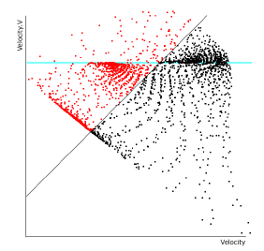
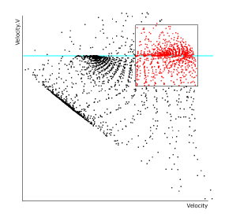
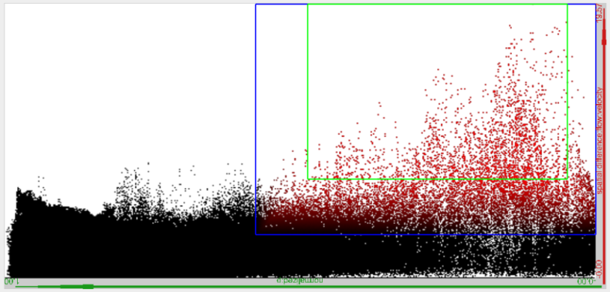
Linking & Brushing
Juxtaposition
Linking: Coordination between views
Brushing: Select groups of data points
Geometric functions such as:
Rectangles, angles, free-form, lassos, etc.
Can be composite (AND, OR)
Can be continuous (smooth brush)
[Doleisch et al. 2004]
[Hauser et al. 2002]

Slide 22
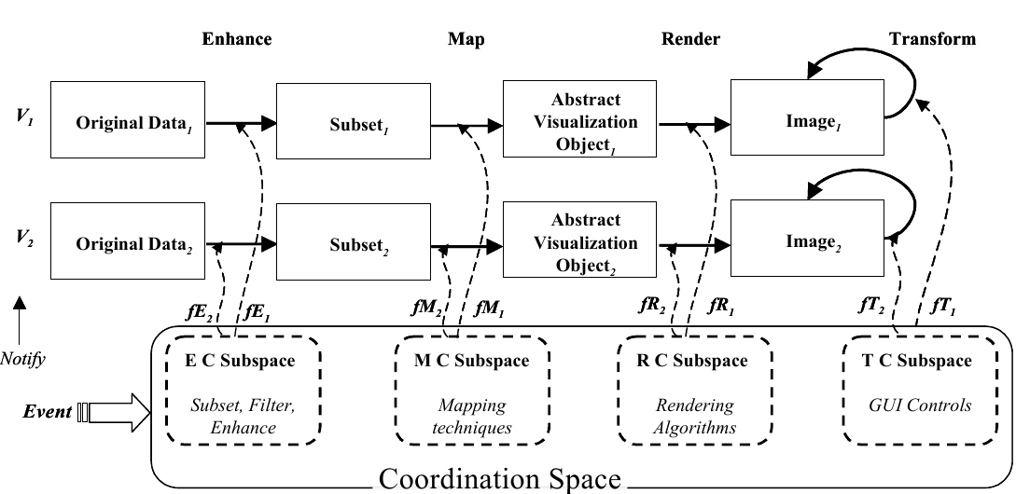
Coordination on Different Levels
Juxtaposition
Most Common Types
Brushing
Navigational slaving (transformation, rotation)
Instead: coordinate on all levels of Vis Pipeline
[Boukhelifa et al. 2003]

Slide 23
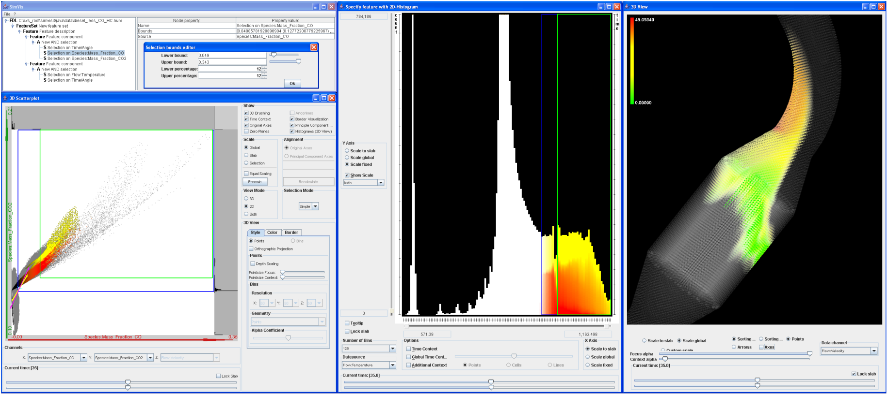
MCV Type 1
Juxtaposition
Different visualization techniques showing the same data
SimVis [Doleisch 2004]

Slide 24
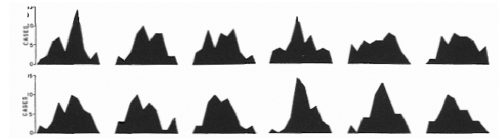
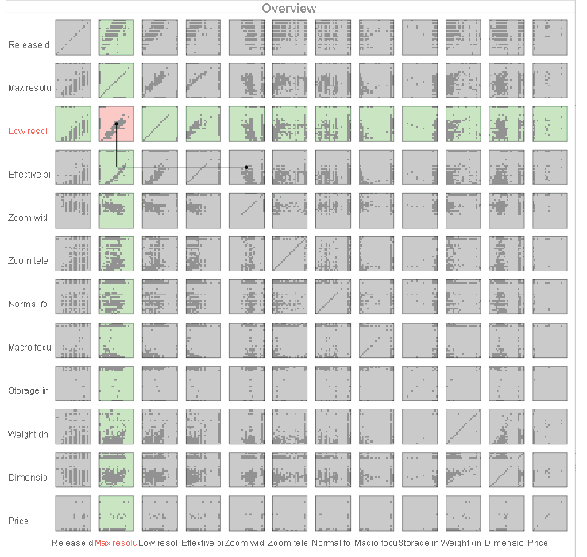
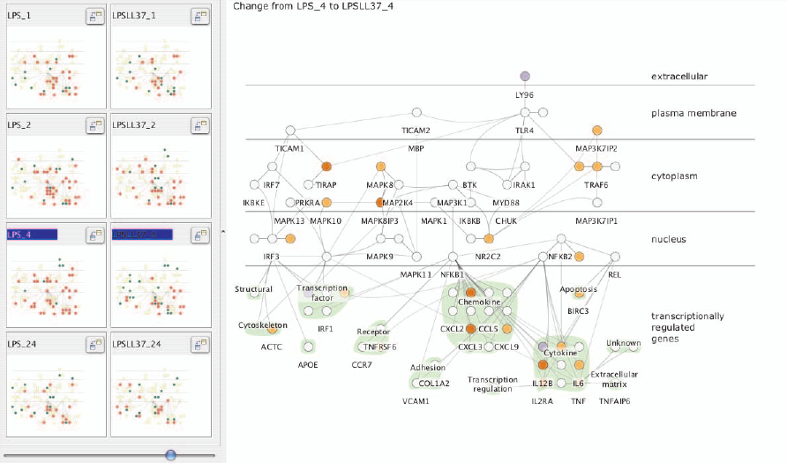
MCV Type 2: Small Multiples
Juxtaposition
Same visualization technique showing different data
[Tufte 1993]
Cerebral [Barsky et al. 2008]
Rolling the Dice [Elmqvist et al. 2008]

Slide 25
Guidelines for Using MCV
Juxtaposition
Rules on how to use multiple views → see [Baldonado et al. 2000]
Cost-Benefit Tradeoffs
Cognitive aspect
The time and effort required to learn the system
The load on the user’s working memory
The effort required for comparison
The effort required for context switching
System aspect
Computational requirements
Display space requirements
Notes:
Rule of Diversity
Use multiple views when there is a diversity of
attributes, models, user profiles, levels of abstraction, or genres.
Rule of Complementarity
Use multiple views when different views bring
out correlations and/or disparities.
Rule of Decomposition
Partition complex data into multiple views to
create manageable chunks and to provide insight
into the interaction among different dimensions.
Rule of Parsimony
Use multiple views minimally.

Slide 26
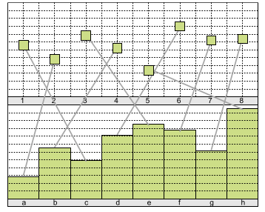
Composite Vis: Integrated Views
Visual composition is the same as for juxtaposition
Adds explicit visual links

Slide 27
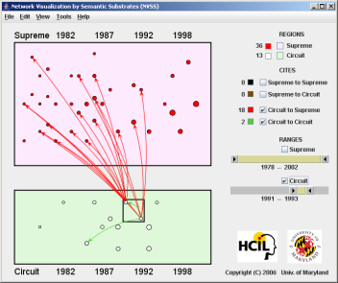
Semantic Substrates
Integrated Views
[Shneiderman and Aris, 2006]
Graph results in a too complex visualization to interpret
User-defined semantic subsets
Visual links connecting identical items across visualizations
Single visualization Single relationship

Slide 28
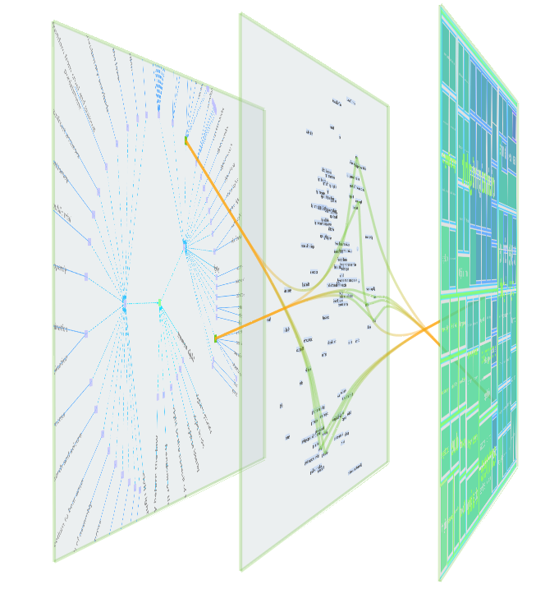
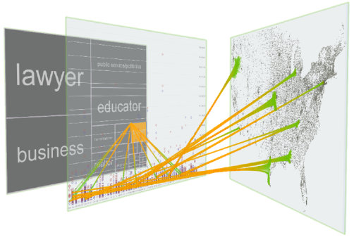
VisLink
Integrated Views
[Collins and Carpendale 2007]
Multiple relationships / datasets
Multiple visualizations
Inter-plane edges

Slide 29
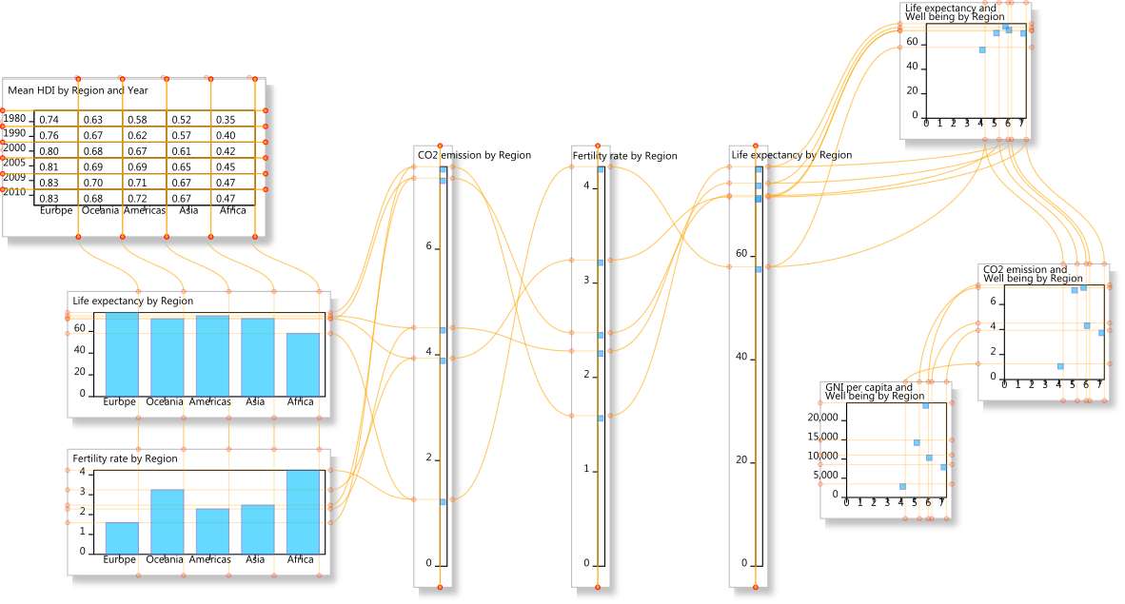
Connected Charts
Integrated Views
[Viau and McGuffin 2012]
Notes:
Relationships between multiple charts
A ConnectedChart showing a text table, bar charts, parallel coordinate axes, and scatterplots.

Slide 30
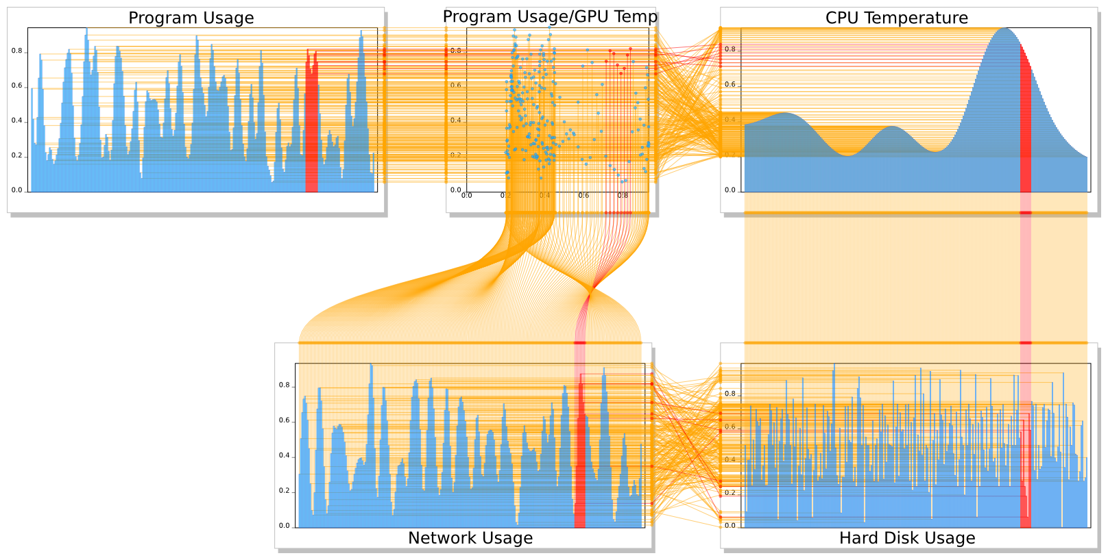
Connected Charts
Integrated Views
[Viau and McGuffin 2012]
Notes:
A ConnectedChart with four barcharts, and a scatterplot, displaying 5 dependent variables that are functions of time.
In this case, GPU temperature is a smooth, slowly varying function of time, hence the connection between the scatterplot’s
horizontal axis and the barchart below it exhibits an interesting, continuous variation. (Synthetic data set.)

Slide 31
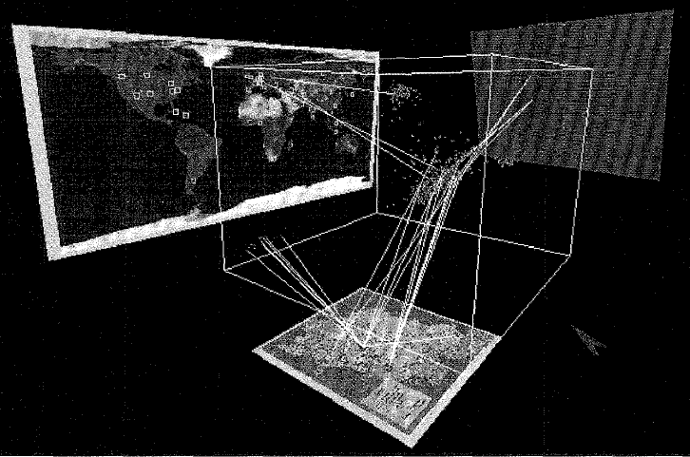
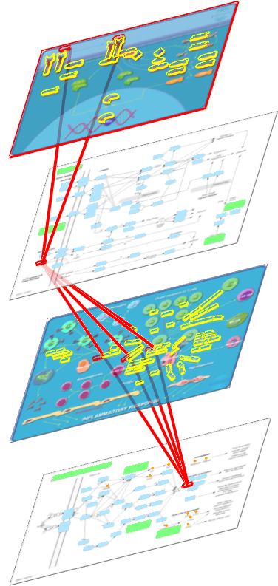
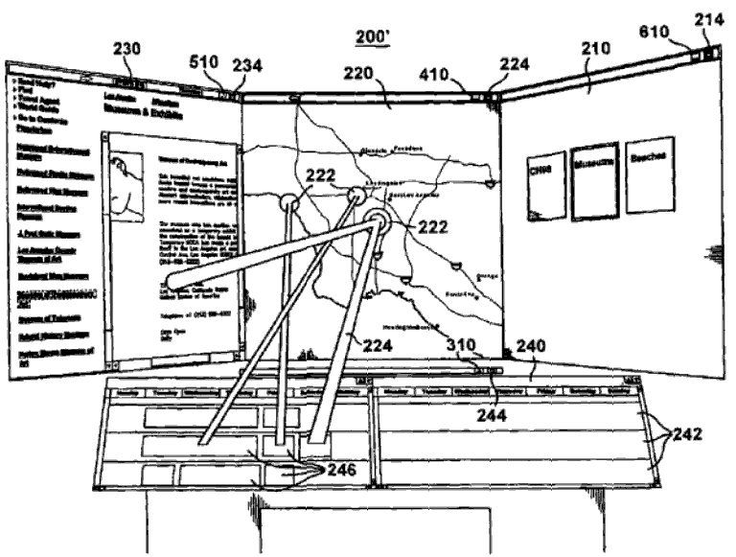
Further Integrated View Examples
[Risch et al. 1996]
Microsoft patent [Höllerer et al. 2007]
Interconnected Pathways [Streit et al. 2007]

Slide 32
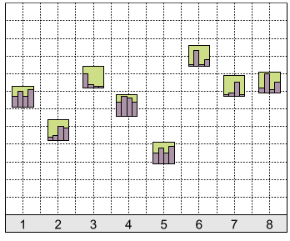
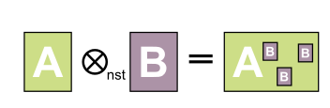
Combined Vis: Nesting
Client visualizations nested inside host visualization
Single or multi view?
Depends on perspective
Notes:
Nested views, like overloaded views, are also based on the notion of
host and client visualizations. However, in this design pattern, one
or more client visualizations are nested inside the visual marks of
the host visualizations, based on the relational linking between the
points. Most often, the nesting is performed simply by replacing
the visual marks in the host visualization by nested instances of the
client visualization.

Slide 33
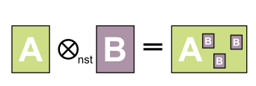
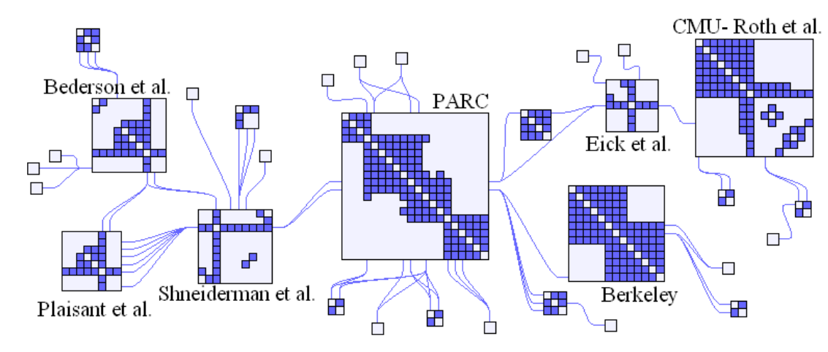
Example 1: Nodetrix
Nesting
[Henry et al. 2007]
Single or composite visualization?

Slide 34
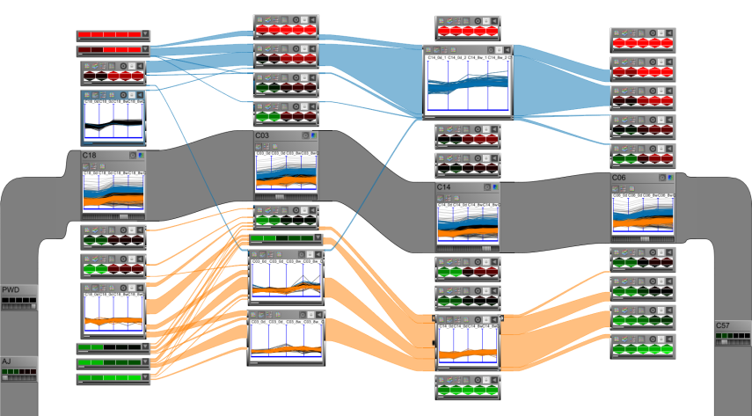
Example 2: VisBricks
Nesting
[Lex et al. 2011]
Single or composite visualization?
Notes:
Handle more data

Slide 35
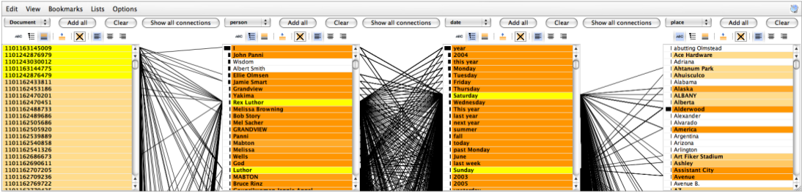
Example 3: Jigsaw List View
[Stasko et al. 2008]
Single or composite visualization?
Notes:
Distinction often not clear

Slide 36
Linking ACROSS Applications
Display 1
Display 2
Application 1
Application 2
Application 3
Visualization 1
Visualization 2
Visualization 3
Visualization 4
User 1
User 2
User 3

Slide 37
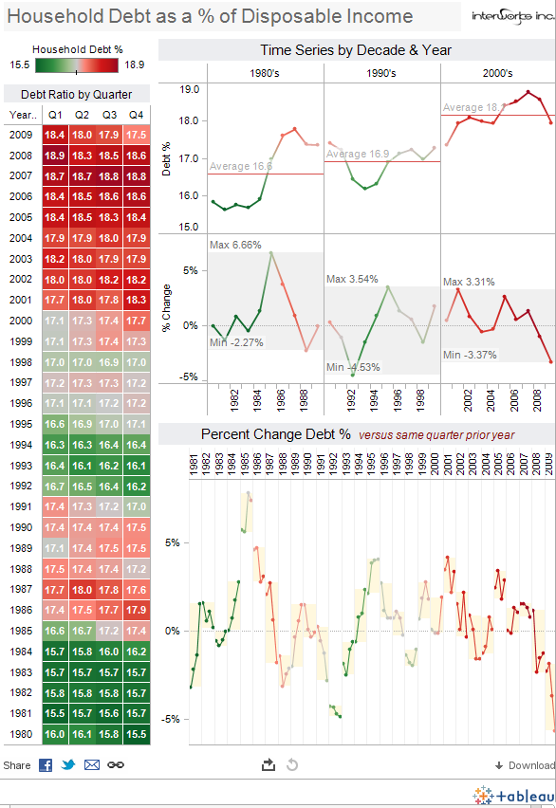

Domain specific specializations:
Banking, Consumer Packaged Goods, Education, Game Design, Government, Healthcare, Insurance, Manufacturing, Oil And Gas, Real Estate, Retail, Securities And Investments, Communications

Slide 38
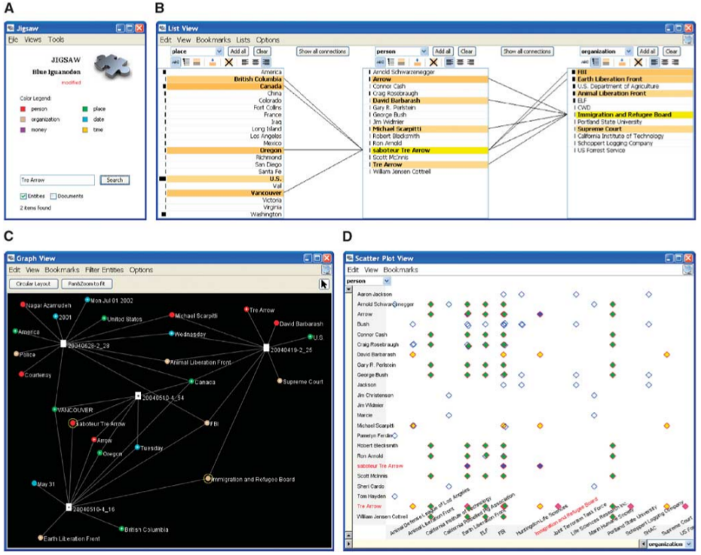
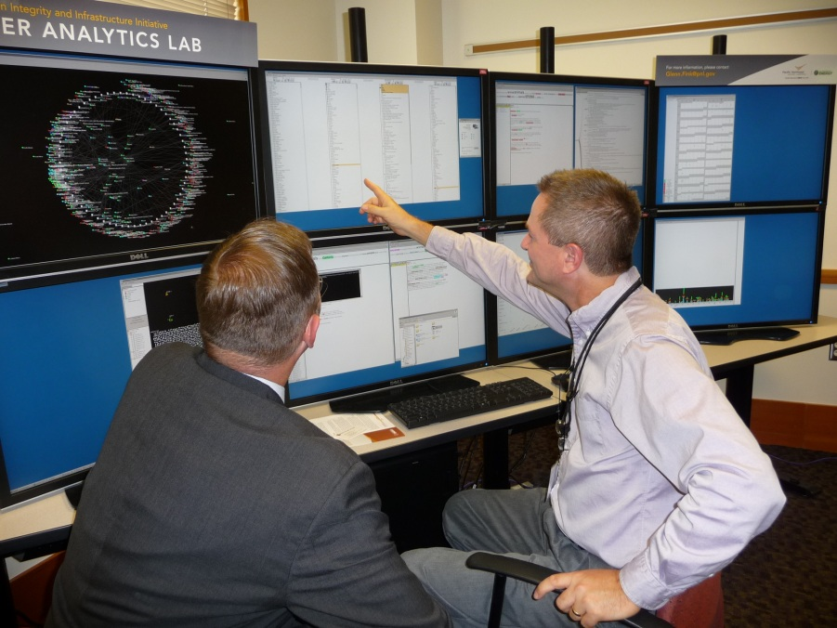
Jigsaw
[Stasko et al. 2007]
Notes:
Examples from scientific community
List: relations between people, places,

Slide 39




Caleydo
[Partl et al. 2012]
[Streit et al. 2012]
[Lex et al. 2012]

Slide 40

Super Application?
Super Application that can visualize everything
Not Feasible! Solution: use existing applications
Downsides:
not integrated
no highlighting, linking, etc.
Can we solve this?
Notes:
Clinical scenarios
Design decision: should we really integrate a volume viewer in Caleydo? Answer: no, not our focus nor our expertise
Eierlegende wollmilchsau = swiss army knife

Slide 41

Snap-Together Visualizations
Juxtaposition
[North and Shneiderman 2000]
Linking & brushing across multiple applications
Notes:
Connected via a central database
Snap-together: API based on COM, database for synchronization across applications → load, select (synchronized highlighting), synchronized scrolling – our focus: visualizing the relationships between selected items on a crowded desktop
A coordinated visualization environment for exploring Census data of U.S. states and counties, dynamically
constructed using Snap-Together Visualization. Users can explore states from nominal, geographic, and numeric perspectives
using the outliner, map, and scatter plot. Selecting a state displays detailed county and industry information for that state in
the table and Treemap on the right. Selecting Maryland on the map reveals a fairly high ranking in Per Capita Income in the
plot, and immediately reveals in the Treemap that the Services industry in Montgomery County is responsible for a major
portion of that income.

Slide 42


Visual Linking Across Applications
[Waldner, GI 2010] – best paper award
Manuela Waldner

Slide 43

Motivation
Notes:
43
Large, high resolution displays: people usually do not maximize content (wasting display space)
This gets even more

Slide 44


Notes:
44
They rather „carefully coordinate“ their windows on the available screen space
Windows can be arranged so all relevant information is simultaneously visible → results in large amount of visible information
Example:
Planning a trip to a conference:
- web browser with conference website
- web browser with travel information on the country
- map to see where it is exactly located
- and other windows not contributing to this task, but still visible
Comparing information across application windows requires the user to manually search for relevant items, which is exhaustive and error-prone
Visual links:
- connection lines linking related data items across application windows
- strong visual cue to guide attention to relevant (peripheral) display regions and secondary windows contributing to primary task

Slide 45


Visual Links Across Applications
Notes:
45
How do visual links across applications work?
Consider a set of applications which may contribute to the information analysis task
The user registers all these applications to a central management process
The management process is based on the Tomcat Java Application Server.
Communication between the manager and the applications is accomplished HTTP-based → web-browser applications can directly communicate

Slide 46


Triggering Selections
Determined by individual application
Notes:
46
To trigger visual links, the user needs to select an item of interest
How this selection is triggered depends on the application
Examples:
- mouse-over or mouse click
- search boxes
- text selection

Slide 47

Visual Links Across Applications
Notes:
47

Slide 48

Visual Links Across Applications
Notes:
48
The application where the input has been registered sends the selection ID – in this case „Canada“, which the user has entered into a search box – to the management process.
It also reports:
- the application name
- the selection area(s) where occurrences of the search term have been found in application A
The management process then dristributes the selection ID („Canada“) to all remaining registered applications
Applications report selection regions
Then they report back the identified regions to the links manager

Slide 49


Selection Mapping
Applications evaluate incoming selection ID
Notes:
49
The applications now have to map the incoming term onto screen regions
Examples:
- where the string occurs in a text
- query for geospatial location and setting a location on the map window

Slide 50

Visual Links Across Applications
Notes:
50
The application where the input has been registered sends the selection ID – in this case „Canada“, which the user has entered into a search box – to the management process.
It also reports:
- the application name
- the selection area(s) where occurrences of the search term have been found in application A
The management process then dristributes the selection ID („Canada“) to all remaining registered applications
Applications report selection regions
Then they report back the identified regions to the links manager

Slide 51

Visual Links Across Applications
Selection regions are collected and sent to renderer
Notes:
51
As soon as every application has reported back, the collected regions are sent to the renderer application
Each reported region is assigned to a container, which corresponds to the window extents of the application window
Plugin for Linux compositing window manager „Compiz“

Slide 52







Design of Visual Links Across Apps
Notes:
52
Example:
- 4 windows, each containing some regions
- some „invisible“ region (e.g. Content which is currently not visible because it is scrolled away)
- mouse pointer indicates the region where the user has started the request
Step 1:
- all regions in the „source“ window (where user is currently interacting) are connected to the center of gravity of all regions
- this „bundling point“ is where links to all other windows will emerge
- we do this, because we assume the center of interest of the user is currently on this window
Step 2:
- from the center point in the source window, connection lines are calculated to the center points in the target windows
Step 3:
- these lines are intersected with the window boundaries → bundling points for target windows
Step 4:
- from target window bundling points, connections to target regions are calculated
Step 5:
- we avoid intersections with selection regions so valueable information is not hidden by links
- lines are curved around regions resulting in shortest non-intersecting route
- now we still need to treat the invisible regions
Step 6:
- we indicate the existence of hidden regions by drawing arrows at the window boundaries
- arrows show in 4 directions
- length of arrow codes the number of hidden elements

Slide 53

Design of Visual Links
Notes:
53

Slide 54


Design of Visual Links
Notes:
54
Visual links introduce some clutter on the desktop
It is unlikely that users want to see the full links at any time
After a user-defined period, links fade to a user-given alpha value – can be brought back by a keyboard shortcut at any time
Can be switched completely off (and on again) at any time

Slide 55
Application Integration
Application support
Direct support
Software extensions (plug-ins)
Mashup application
OCR‏
Notes:
55
Applications using visual links have to use the visual links software API
- they have to register and report the visible window region
- they have to provide a user interface to trigger selections
- process incoming selection IDs and map them to regions within the application window (and report these regions as a response to the requst)
- report changes in window content (e.g. If the content is scrolled) so visual links can be re-calculated
We created examples for all three support mechanisms
Application integration can either
- directly support the API (i.e. Integration into existing software)
- be used as mashup
- be extended through a plug-in
Direct support: full access to user interface and information → elaborate interaction techniques and sophisticated ID mapping
Mashup: re-using powerful APIs, integration of sophisticated user interface but ID mapping limited to existing API
Plug-ins: access to arbitrary data and high number of application scenarios – many tools can be extended this way (e.g. Web browser, office tools) but information access and user interface options are limited

Slide 56

Direct Application Support
Extending Caleydo visualization framework
Internal highlighting → coordinates are sent to manager
Notes:
56
3) Direct support: visualization framework
Extending the existing Caleydo visualization framework: multiple coordinated views originating from biomedical domain but can also treat arbitrary data
Brushing and linking; synchronized highlighting
Item selection by moving the mouse pointer over an element
Integrating selection mechanism in visual links API → incoming and outgoing selections

Slide 57

Software Extension
Mozilla Firefox web browser add-on
Access to DOM of HTML-document
Temporarily enclosing selection ID with <span>-tag
Notes:
57
Software Extension
Add-on for popular web browser Mozilla Firefox
Add-ons have full access to document object model of the displayed HTML-document
Processing incoming request: searching DOM for search string and finding region by temporarily enclosing string with <span> tag
Report selections: selecting word in browser and pressing a button integrated in toolbar

Slide 58

Mashup Application
HTML-page utilizing JavaScript and Google Maps API
Geographic location associated with selection ID
Reports bounding rectangle around screen coordinates
Notes:
58
2) Mashup
Google maps API integrated in simple HTML-page with JavaScript
Processing incoming request: search Google Maps API and retrieving geographic location associated with string (first hit); API provides method to convert geographic location to window position; small bounding rectangle around window position
User interface: search box to enter search string → sending to Google Maps API

Slide 59

Usage Scenario: Biomedical Analysis
Notes:
59
Usage scenario 1:
Information from external sources can be integrated in the visualization framework
Example: information of genes on the web are linked to gene expression data visualized in different visual representations of the framework

Slide 60

Usage Scenario: Economic Statistics
Notes:
Usage scenario 2:
Data from other domains can be handled in special-purpose visualization framework
External applications are used as supportive views
Example: economic statistics data linked to world map → geographic information without integrating a map view into visualization framework

Slide 61

Soon Available: Routed Visual Links Across Apps
Light-weight app that renders on top of desktop
Real-time, OS-independent

Slide 62
What’s missing: Linking beyond Strings
Data
Abstractions
Selections
Intermediate processing results
Meta-data
Groups (clusters)
Interaction
→ As discussed in Part I

Slide 63


Domain specific coordination project for systems biology
Broad Institute
http://www.genomespace.org
Allows to move data(sets) smoothly between applications

Slide 64

Domain specific coordination project for systems biology
Institute of Systems Biology
http://gaggle.systemsbiology.net/
Also integrates analytical tools such as R

Slide 65
Allows to exchange:
Name list
Clusters/groups
Tuple: a collection of name/value pairs
Matrix (rows and columns)
Network: a collection of nodes and edges

Slide 66

Firefox toolbar for the Gaggle

Slide 67
Obvious
[Fekete et al. 2011]
Meta-Toolkit to Encapsulate Information Visualization Toolkits
http://code.google.com/p/obvious
Deep integration between frameworks
Unifies Prefuse, the InfoVis Toolkit, partly Improvise, JUNG and other data management libraries

Slide 68
Linking ACROSS DISPLAYS / USERS
Display 1
Display 2
Application 1
Application 2
Application 3
Visualization 1
Visualization 2
Visualization 3
Visualization 4
User 1
User 2
User 3

Slide 69

Collaborative Information Analysis
Notes:
In nowadays computing systems, there are several deficites impeding collaborative information analysis:

Slide 70

Collaborative Information Analysis
Notes:
Input is usually restricted to a single collaborator
→ one user is taking control

Slide 71

Collaborative Information Analysis
Notes:
Experts from different domains may prefer different role-specific visual encodings or specialized applications

Slide 72

Collaborative Information Analysis
Notes:
Screen space limitations do not allow synchronous display of specialized information
Leads to input conflicts

Slide 73


Collaborative Information Analysis
Separation
Individual information extraction
Discussion of individual contributions
Notes:
As a result:
Information is individually extracted and later discussed as a team

Slide 74


Collaborative Visual Analysis
Interdisciplinary analysis problems
Single domain expert may not be enough → Need for collaboration
Pathologist
Geneticist
Biologist
[Streit et al. 2009]
[Waldner et al. 2009]
Notes:
Uses Deskotheque as infrastructure

Slide 75

Collaborative Brushing and Linking
[Isenberg and Fisher 2009]
Co-located Visual Analytics of Document Collections
Notes:
We present Cambiera, a tabletop visual analytics tool that supports individual and
collaborative information foraging activities in large text document collections. We define collaborative brushing
and linking as an awareness mechanism that enables analysts to follow their own hypotheses during collaborative
sessions while still remaining aware of the group’s activities. With Cambiera, users are able to collaboratively
search through documents, maintaining awareness of each others’ work and building on each others’ findings.

Slide 76


LARK: Coordinating Co-located Collaboration with InfoVis
[Tobiasz et al. 2009]
MCV on large multi-touch displays
Explicitly indicating coordination points on
data, representation, presentation, and view level
Notes:
Large multi-touch displays are expanding the possibilities of multiple-coordinated views by allowing multiple people to in
teract with data in concert or independently. We present Lark, a system that facilitates the coordination of interactions with information
visualizations on shared digital workspaces. We focus on supporting this coordination according to four main criteria: scoped interac-
tion, temporal flexibility, spatial flexibility, and changing collaboration styles. These are achieved by integrating a representation of the
information visualization pipeline into the shared workspace, thus explicitly indicating coordination points on data, representation, pre-
sentation, and view levels. This integrated meta-visualization supports both the awareness of how views are linked and the freedom
to work in concert or independently. Lark incorporates these four main criteria into a coherent visualization collaboration interaction
environment by providing direct visual and algorithmic support for the coordination of data analysis actions over shared large displays.

Slide 77

Collaborative Info Linking
[Waldner et al. 2011]
Notes:
Bridging Knowledge Gaps between Users by Linking across Applications

Slide 78

Collaborative Info-Linking Approach
Collaborative environment that provides:
Unmodified single-user application support
Sufficient screen space
Multi-pointer support
User-specific visual links across applications
Protecting workspaces
Storing and sharing
Notes:
We build upon a collaboration-transparent environment which provides:
Multi-user input support on windowing system level – this means: applications do not have to take care of multiple input streams for themselves
And
Providing tiled projected displays on window manager level – this means: we have multiple projectors, which are casually aligned and the window manager corrects the resulting desktop image transparently to the applications
This fulfills the requirements:
- single-user application support (application transparency)
- sufficient screen space → we can create very large displays from multiple projectors (limited to maximum number of output devices per machine – using VGA splitters can double / triple the amount)
- multi-user input
Collaborative information linking:
Modifies applications in a minimally invasive way:
User selections are visualized by user-specific visual links across applications
→ help to localize important information on the cluttered screen
→ provide awareness cues of other user‘s current investigations
Application windows can be protected from other users‘ links
A central selection storage tool allows to collect selections and to replay links later (by oneself or other persons)
We need sufficient screen space to arrange multiple application windows (should be side-by-side if multiple users are collaborating)
Also: users want to establish their personal territories (important for coordinating activities)
Multiple sources and a lot of screen space to arrange items side-by-side → a lot of visual information → we need visual cues to localize relevant information
(useful for individual information extraction but also for discussion → deictic referencing)
Cues should be personalized and consistent across the entire desktop
Concurrent input, visual coordination → interference when working individually
Known interferences from related work: changes in spatial window layout, cursor movements by other users
Providing protected spaces (e.g. Areas on a shared screen, private displays) for uninterrupted private work
providing possibility to lock or protect certain workspace artifacts (e.g. Application windows)
Users should be enabled to record their findings for later review and discussion
We are using multiple applications → storing tool should be centralized and unified
Findings should be saved in a generic form

Slide 79


Large displays
Casually aligned multi-projector displays
Compiz extension for tiled displays [Waldner et al., EDT/IPT 2008]
Warping and blending of overlapping projections in the window manager → application transparent
Notes:
Large, seamless, high-resolution displays are created from multiple overlapping projections
Using a Compiz extension which applies warping and blending on window manager level
Application transparent and interactive framerates
Six projectors, overlapping
Window manager applies warping of projected images...
And blending of overlap regions
Two cursors are concurrently interacting with two application windows
So in this setting, two users can work independently in different application windows and have enough space to establish their territories
Applications shown are unmodified

Slide 80







Linking Infrastructure
Notes:
Given multiple single-user applications
Applications need to minimally modified – they need to:
- provide interaction techniques for user selections
- (browse their content for an incoming selection and find out the bounding rectangles of the discovered selections)
All applications communicate with a central management application
Management application is implemented as Tomcat Java application server – communication with applications takes place in HTTP
Finally, the window manager:
Based on Compiz, extended via plugin infrastructure
multi-pointer plugin rendering multiple pointers and providing interface to query user identities
Links rendering plugin receives bounding rectangles for different application windows, then routes and renders the links
Warping and blending plugin takes care to undistort and blend multiple overlapping projections
Application 1 receives a selection
Looks for occurrences in its content
Reports selection string and corresponding bounding rectangles to management application
Management application consults multi-pointer plugin:
Plugin returns pointerID of latest active pointer within window boundaries
(simple, but works – never detected any problems, also in user study)
Management application detects access rights for this pointer (which applications are accessible? Which are locked by other users?)
Sends selection string to all accessible applications
(in this case app 3)
Application responds with bounding rectangles
Bounding rectangles and color associated with pointer is sent to rendering plugin
Plugin clears previous set of links and renders new one
String based - OCR possible as well
If one of application reports window change (e.g. A user has scrolled a page)
→ All link sets branching to this app need to be re-rendered

Slide 81

Collaborative Info Linking Video
Notes:
User left selects word in a browser and presses an embedded button to invoke linking
Links are rendered to all application windows containing instances of the selected string
Multiple sets of links are color-coded like their pointers
In this example: two different application examples:
Firefox extended by simple add-on (searches occurrences in text and image tags)
Google maps mash-up using Google maps API to search for geographic locations and to map these locations to screen positions

Slide 82



Collaborative Information Linking
Notes:
Example:
Shared overview map, very coarse
Seeing how selections relate to each other on the overview
Not required to change representation to search for occurrences (where is D-Clucuronate? → just select it for linking, no need to search in KEGG table)
Problem:
When other user makes a selection, link may unexpectedly intrude other user‘s current focus window
→ Users can lock their windows

Slide 83

Window Protection
Notes:
Just pressing a keyboard shortcut on focus window
If not already locked by another user, window is now locked for other users‘ links
Visualized by colored border in pointer color

Slide 84

Selection „Hijacking“
Notes:
Quickly check whether other user‘s selection is contained in own (locked) window:
Move cursor on top of another user‘s selection rectangle
Own links are temporarily exchanged
Move cursor away
Own links re-appear
For quick checks and comparisons of different user selections

Slide 85


Selection Storage and Management
Bookmark list as central storage and global search tool
Notes:
We provide a simple bookmark list which can be used as central storage tool, but also as global search tool
Shows current selection strings by all users and also provides an empty field where user can enter any string and look for occurrences in other windows
Clicking on „bookmark“ creates a labeld button
User clicks on button → links emerge
VIDEO:
Left user: selecting bookmarks from list
Later: selecting item in web browser text → sees that other user has bookmarked this item before → start discussion
In this example: bookmark lists for two users – yellow link shows that one item has been bookmarked by both users → probably interesting

Slide 86

One-Shot Linking
Light-weight linking from unmodified applications
Text selection → keyboard shortcut → selection buffer
Notes:
Other way for storing selections:
Arbitrary, unmodified applications (e.g. Spreadsheet applications, text editors etc.)
User selects a word and presses a keyboard shortcut
Manager consults OS selection buffer → selection string
Sends selection string to all accessible applications
Restrictions:
We cannot access content of applications
- we can only link FROM these apps, but not into
- we cannot visualize other instances in this application when linking from it
- we don‘t know where the string is actually located → rendering from mouse pointer location
We cannot detect changes in these apps
→ links are only shown temporarily

Slide 87


Observational Experiment
18 participants (16 males, 2 females) - pairs
Analysis of migration from Africa to Europe
Observations, video / audio recording, questionnaires, interview
Notes:
Observational experiment in a collaborative information analysis task
Goal: initial assessment of collaborative information linking and our infrastructure
18 participants, working in pairs
Each user had own mouse and keyboard pair and color-coded pointer (yellow and red)
Task: analysis of migration from Africa to Europe
Available material: map and data from the web (migration table, newspaper articles); slightly shortened
More information in the paper
Maximum of 30 minutes (some were finished earlier)
Windows:
Shared migration table and map, one bookmark list of the left, simple, unmodified editor on the right, on each side a browser window containing the articles (the same) – windows protected
There was also pen and paper on the desk, but nobody used it
Warm-up period:
Intruction how to invoke linking, how to switch off / fade links, how to bookmark, how to protect / unprotect windows
Collected data: field notes, video recording with audio, questionnaires, semi-structured interview in the end

Slide 88


Results
Usage of information linking depends on work style
Individual information retrieval → links to locate info
Joint discussion → one set of links only
Mixed-focus collaboration: most frequently
Notes:
Observation:
User of collaborative information linking depends on work style:
Most groups: mixed-focus collaboration: switching between individual work and tightly coupled collaboration (e.g. Discussions, task division, clarification etc.)
Others: working individually on different questions, tightly collaborating (no individual work), single active user and passive observer
Linking used most when working in mixed-focus style:
Usually individual information retrieval period after discussing task division and clarifying questions:
Linking used to locate countries on map and to find associated numbers in table
Tight collaboration (discussing individual findings):
One set of links faded or switched off
One user taking control to summarize findings, clarify etc.
Linking to visualize location or to clarify on unknown items → support in deictic referencing (no problems resolving deictic references observed)

Slide 89
Results
Distractions and conflicts
In general distraction was assessed as low
Input conflicts on shared windows, changes to window layout
Could be resolved by social protocols, but subjectively annoying
Territoriality
Window ownership based on initial window layout
Movement of shared windows rare
Notes:
Surprising: distraction was assessed as low
(There was distraction, but mainly caused by occasional input conflicts on shared windows or if the window layout was changed)
Sometimes: one user silently watching other user‘s links
We observed input conflicts on shared windows (e.g. One user drags the map, other enters with pointer → map starts flickering) and
Users reported that they were annoyed by other user‘s window layout changes
Observed that these issues could be resolved by social protocols (was immediately resolved: „ups, sorry!“) but
Users reported that they were very annoyed
As observed by many other researchers, we also saw a strong sense of territoriality based on initial window layout
(users were instructed that they could change the window layout but except for the group working in a tightly coupled fashion, this was rare)
Example: bookmark window was on the left, text editor on the right, initially:
shown is the average number of linking invoked from the bookmark list and editor, respectively → corresponds to the closest user
Movement of shared windows was rare and if, users always discussed that before-hand

Slide 90
Open Issues
What about visual clutter when more users are interacting?
How to handle discontinuous multi-display/projector setups?

Slide 91

Virtual Reality
Visual links in immersive environments
Biological Network Analysis in VR [Dickerson et al 2002]
Notes:
Early examples of using explicit linking from the VR community

Slide 92
Tutorial Summary
Connecting the Dots

Slide 93
Summary Part I – What to Link
Relations differ in their:
Cardinality
Elements (Granularity + Scope)
Domain
Relations can be derived or inherent
Examples given show what‘s already been done
– and what’s still left to explore!

Slide 94








Summary Part II – How to Link

Slide 95
Summary Part III – When to Link
Display 1
Display 2
Application 1
Application 2
Application 3
View 1
View 2
View 3
View 4
User 1
User 2
User 3

Slide 96



Connecting The Dots Showing Relationships in Data and Beyond
connecting-the-dots.caleydo.org
?
Marc Streit
Hans-Jörg Schulz
Alexander Lex
marc.streit@jku.at
contact@hjschulz.net
alex@seas.harvard.edu

